Slide 1
Heart Disease Diagnostic
Samuel Nadar

Slide 2
Introduction

Slide 3
Health is real wealth in the pandemic time we all realized the brute effects of covid-19 on all irrespective of any status.
To analyse the health and medical data for better future preparation.
Heart disease is a leading cause of death worldwide, impacting millions of people annually.
Heart disease imposes a significant economic burden due to healthcare costs and loss of productivity.
Increasing awareness and education about heart disease is crucial for prevention and early detection.

Slide 4
Attribute Information

Slide 5
age
sex
chest pain type (4 values)
resting blood pressure
serum cholesterol in mg/dl
fasting blood sugar > 120 mg/dl
resting electrocardiographic results (values 0,1,2)
maximum heart rate achieved
exercise induced angina
oldpeak = ST depression induced by exercise relative to rest
the slope of the peak exercise ST segment
number of major vessels (0-3) coloured by fluoroscopy
thal: 0 = normal; 1 = fixed defect; 2 = reversable defect

Slide 6
Technology Stack

Slide 7






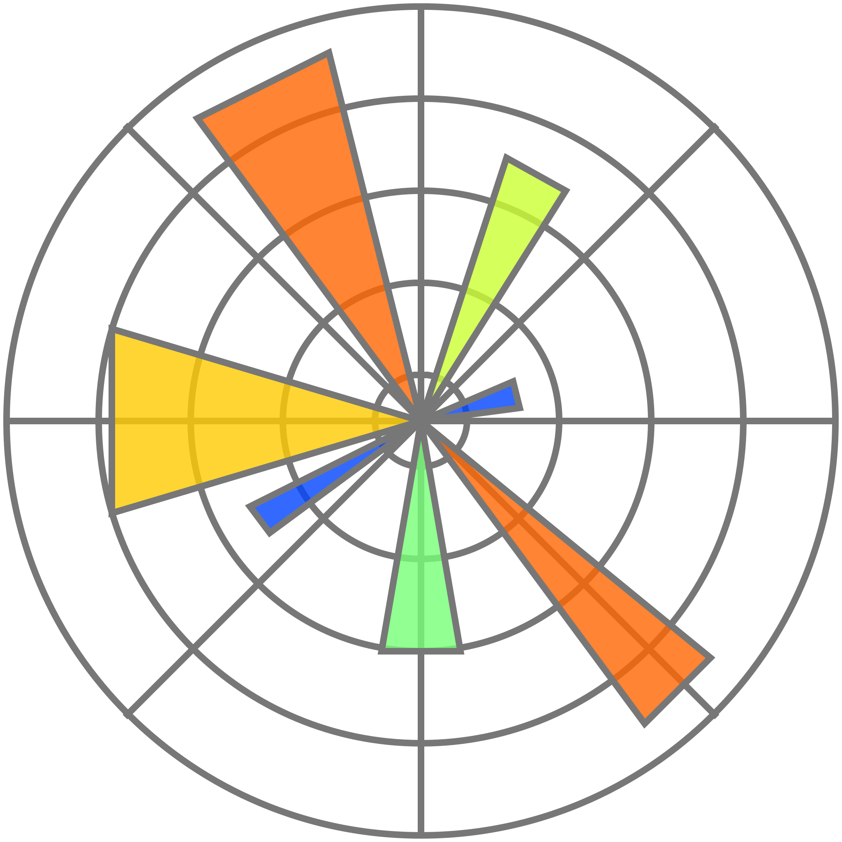







Slide 8
Steps in Data Analytics

Slide 9
Data Preprocessing (ETL)
Exploratory Data Analysis (EDA)
Machine Learning Algorithm (Classification)
Dashboard

Slide 10
Exploratory Data Analysis (EDA)

Slide 11
Around 48.68% of people have heart disease
Gender 0 (72.44%) tend to have more heart disease than gender 1 (42.08%)
At around age of 41 to 50, people tend to have more heart disease (67.21%) and above age of 60 people tend to have less heart disease (40.81%)
Type 0 chest pain mostly does not imply heart disease. Type 2 chest pain is the mostly observed in case of heart disease
In case of heart disease, the slope of the peak exercise ST segment is mostly 2. The slope being 1 mostly implies the absence of heart disease
In case of heart disease, generally none of major vessels are coloured by fluoroscopy
Reversible defect in thalassemia has higher chance of heart disease
Presence of Exercise induced angina generally implies the absence of heart disease

Slide 12
CONTD.
In case of exercise induced angina, chest pain is mostly of type 0
In case of heart disease maximum heart received achieved is elevated
In case of slope of the peak exercise ST segment being 2 the maximum heart received achieved is more than slope of the peak exercise ST segment being 1
In absence of exercise induced angina maximum heart received achieved is elevated
Maximum heart rate achieved is less in case of chest pain type 0
As age increases, maximum heart rate achieved decreases
In case of heart disease oldpeak is depressed with a higher chance of being 0
Oldpeak reduces with maximum heart rate achieved

Slide 13
Correlation Patterns

Slide 14
Few Interesting Correlation
exercise induced angina with chest pain
maximum heart rate achieved with slope of the peak exercise ST segment, exercise induced angina, age
oldpeak with the slope of the peak exercise ST segment [very good], maximum heart rate achieved

Slide 15
Correlation with Heart Disease
Feature | Correlation Coefficient | Inference
resting blood pressure, serum cholestoral in mg/dl, fasting blood sugar > 120 mg/dl, resting electrocardiographic results | 0 - 0.15 | Weak Correlation
age and sex | 0.15 - 0.3 | Moderate Correlation
chest pain, maximum heart rate achieved, exercise induced angina, oldpeak, thal, the slope of the peak exercise ST segment, number of major vessels coloured by fluoroscopy | 0.3 - 0.5 | Good Correlation

Slide 16
Machine Learning

Slide 17
Fundamental Steps in ML
Data Preprocessing
ML Algorithm Selection
Fitting the Model
Model Evaluation
Confusion Matrix, ROC Curve, Accuracy, Precision, Recall, F1 - score

Slide 18
Performance of MODEL
LightGBM, XGBoost, Gradient Boosting Classifier, Support Vector Machine > Random Forest Classifier > Neural Networks > Logistic Regression > Naive Bayes

Slide 19
Dashboard

Slide 20
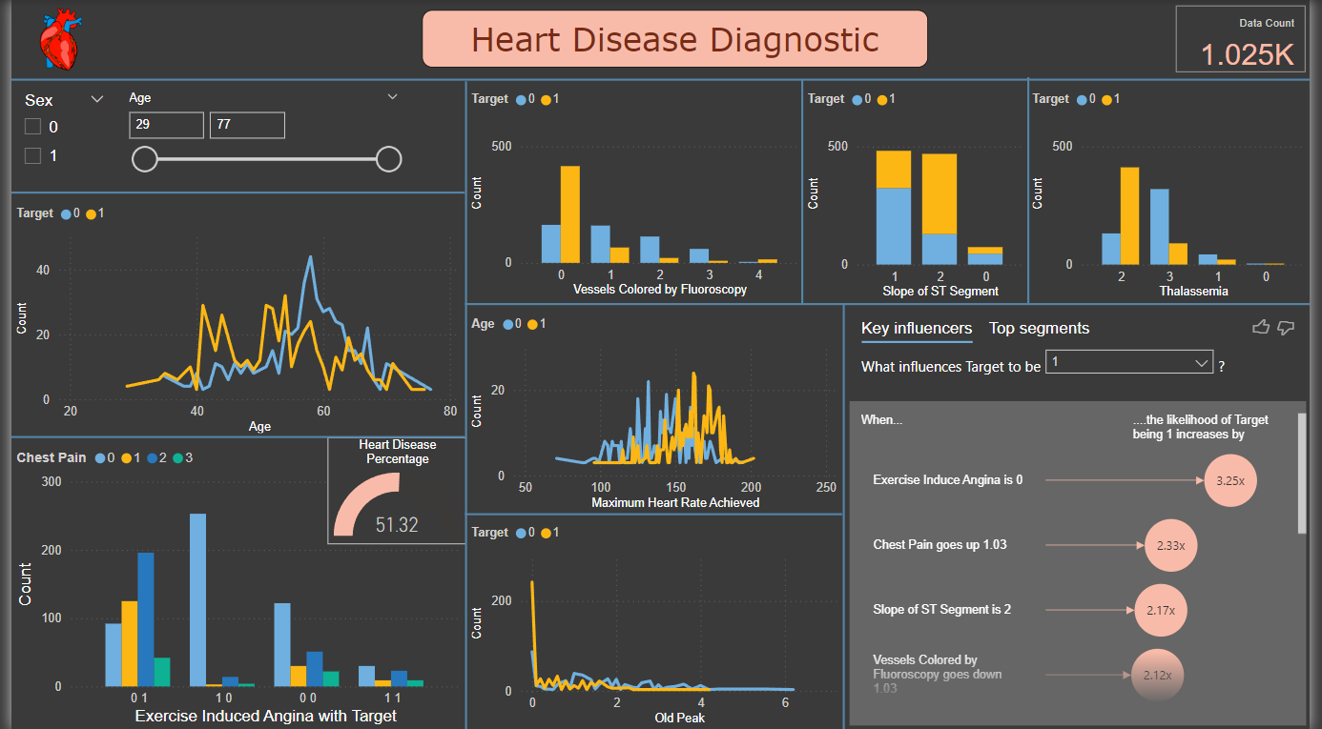

Slide 21
Thank You

